Slide 1
ANALOG TV – RECEPTION AND COLOR TV

Slide 2
Topics
Analog TV reception
    TV Receiver Block Diagram
    CRT
    Interlaced scanning
    Progressive scanning
Color Television
    Color TV Screen
    Color TV signal

Slide 3
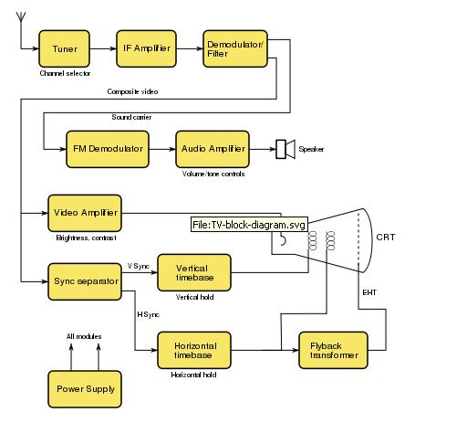
TV Receiver Block Diagram

Slide 4
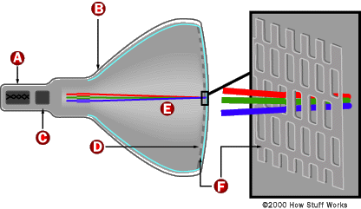

Cathode Ray Tube (CRT)
A single electron beam scans a phosphor screen from left to right and then
returns to the top. This is called a “flying-spot CRT”
The electron beam is brightness-modulated to create intensity changes which
cause the different shades of grey.
Alternative forms of display is an LCD screen, but the picture display is still
updated one frame at a time in the same manner as the CRT.

Slide 5
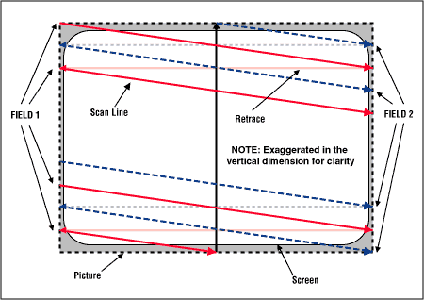
Interlaced scanning
There are 2 types of scanning systems
  Interlaced scanning
  Progressive scanning
Interlaced scanning
  Each picture or frame is divided into two separate sub-pictures called ‘fields’
  Field 1 contains all the odd lines of the image (lines 1 through 262 ½)
  Field 2 contains all the even lines of the image (lines 262 ½ through 525)
  An interlaced picture is painted on the screen in two passes, by first scanning the horizontal lines of the first field and then retracing to the top of the screen and then scanning the horizontal lines for the second field
  This is used in Television signals
  Note
  Vertical blanking interval (VBI) is the time difference between the last line of one frame or field of a raster display, and the beginning of the next frame or field
  Horizontal blanking interval is the time difference between end of one line and the starting of next line to allow the beam to return from right to left

Slide 6
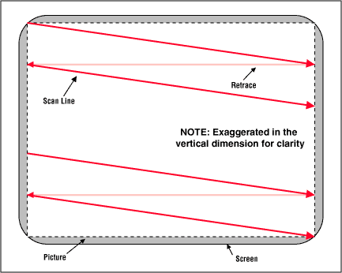
Progressive Scanning
  Progressive scanning is also called non-interlaced or sequential scanning
  The picture is painted on the screen by scanning all of the horizontal lines of the picture in one pass from top to the bottom
  This is used in computer monitors, LCD screens

Slide 7
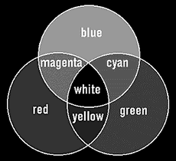
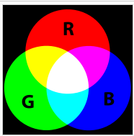
Color Television
Luminosity is the basic principle of black-and-white TV
Additive color mixing is the basic principle of Color TV
Primary colors (RGB – Red, Green, Blue) are used to create all the colors that can be found in the color spectrum.
Hue and saturation information added to the monochrome signal

Slide 8
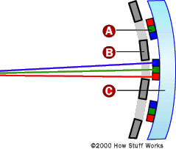

Color TV Screen
There are three electron beams that move simultaneously across the screen. They are named the red, green and blue beams
The screen is not coated with a single sheet of phosphor as in a black-and-white TV. Instead, the screen is coated with red, green and blue phosphors arranged in dots or stripes

Slide 9
Color TV Screen
On the inside of the tube, very close to the phosphor coating, there is a thin metal screen called a shadow mask
This mask is perforated with very small holes that are aligned with the phosphor dots (or stripes) on the screen
When a color TV needs to create a red dot, it fires the red beam at the red phosphor
Similarly for green and blue dots, green and blue beams are fired
White dot - red, green and blue beams are fired simultaneously
Black dot - all three beams are turned off
All other colors on a TV screen are combinations of red, green and blue

Slide 10
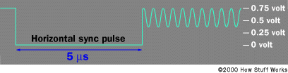
Color TV signal
An extra chrominance signal is added by superimposing a 3.579545 MHz sine wave onto the standard black-and-white signal
Right after the horizontal sync pulse, eight cycles of a 3.579545 MHz sine wave are added as a color burst
Following these eight cycles, a phase shift in the chrominance signal indicates the color to display. The amplitude of the signal determines the saturation
E.g for relationship between color and phase:
  Burst 0 degrees , Red 75 degrees, Green 315 degrees
A black-and-white TV filters out and ignores the chrominance signal.
A color TV picks it out of the signal and decodes it, along with the normal intensity signal, to determine how to modulate the three color beams.
Color TV signal

Slide 11
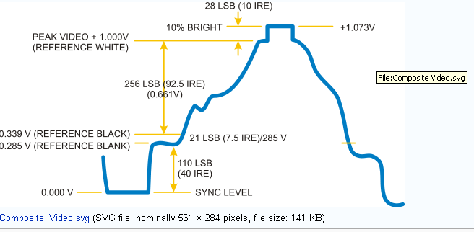
TV Terminology
There are three characteristics of any color – Luminance, Hue and Saturation
  Luminance or Luma: The amount of light intensity as perceived by the eye regardless of the color
  Hue or Tint: The predominant spectral color of the received light
  Saturation: The spectral purity of the color light; an indication of how little the color is diluted by light
  Hue and Saturation put together is known as Chrominance or Chroma
Contrast: The difference between black and white parts of the picture over and above the brightness level
Gamma ratio: It is the logarithmic relationship between brightness and voltage. If a system has a gamma of 1.0, its input-to-output levels are linearly proportional. At a gamma of 0.5, changes in low light levels are more responsive than changes in high light levels. At a gamma of 2.2, changes in low light levels are less responsive than changes in high light levels.
An IRE is a unit used in the measurement of composite video signals. Its name is derived from the initials of the Institute of Radio Engineers.

Slide 12


